Slide 1
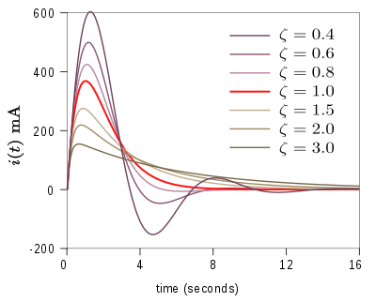
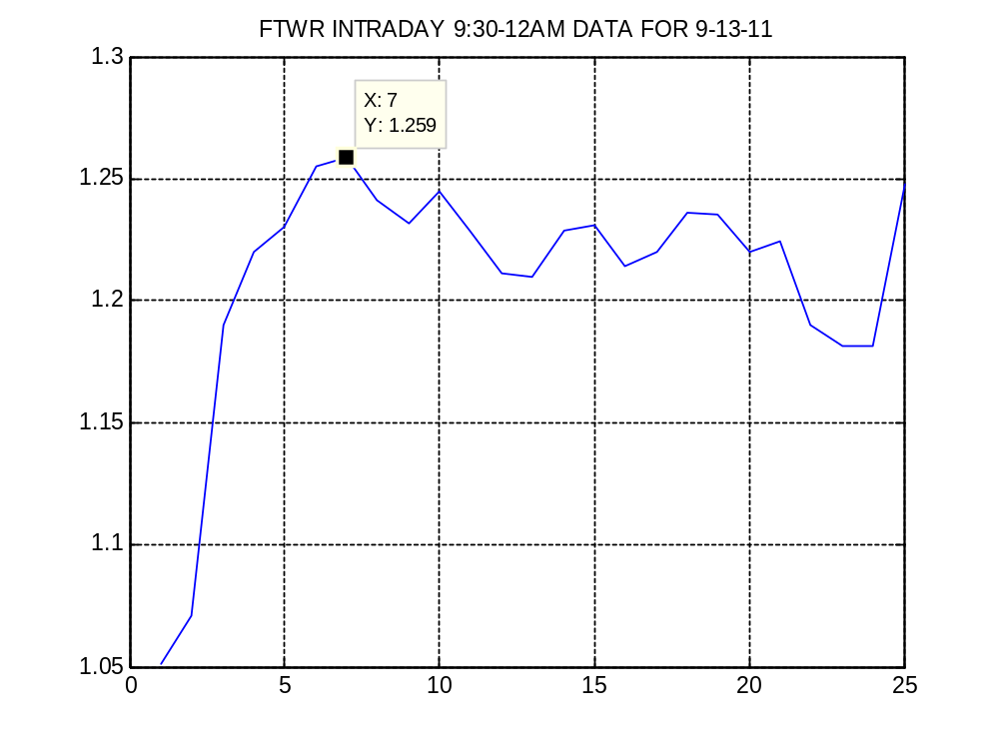
Fitting an Under Damped Vibration Model to Equity Price Events
Here we investigate a vibration model were we see an equity response to a catalyst event as a type of ‘damped vibration’ as frequently used in mechanical engineering

Slide 2
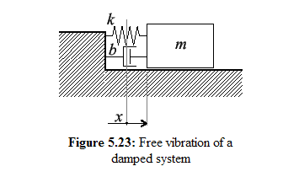
Motivation
Equity data (and other analogous financial data sets) are naturally related to the damped vibration model since:
1) A catalyst (an event) produces the initial force to make the equity prices change drastically (usually an increase at market start or time the event is known – publicly or not - and prompts some investors to buy) as follows:
2) When the price is ‘too high’ for investors/trade programs this acts like a damper on the top since some stop buying and some start selling and this decreases the price or slows the rate of increasing prices
3) When the price is ‘too low’ for investors/trade programs it acts as a damper on the bottom since some will then increase or start buying, some will stop selling and thus increase the price or slows the rate of decreasing prices
4) The movement between these two is the vibration.
5) This is usually called a channel, wedge etc in tech trading terms. Then usually these two converge to a narrow range or a single value.

Slide 3
Engineering Background
Vibrations and transient response are a huge subject in Engineering. We only discuss some basic points that help us understand the model we developed.

Slide 4
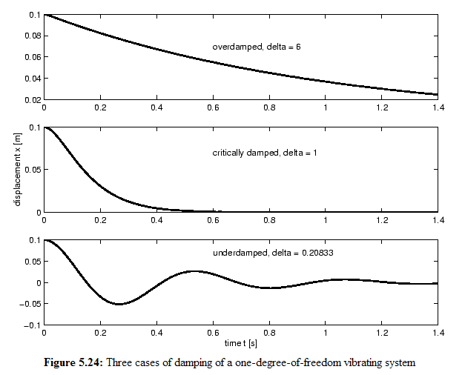
Under Damped vibration

Slide 5
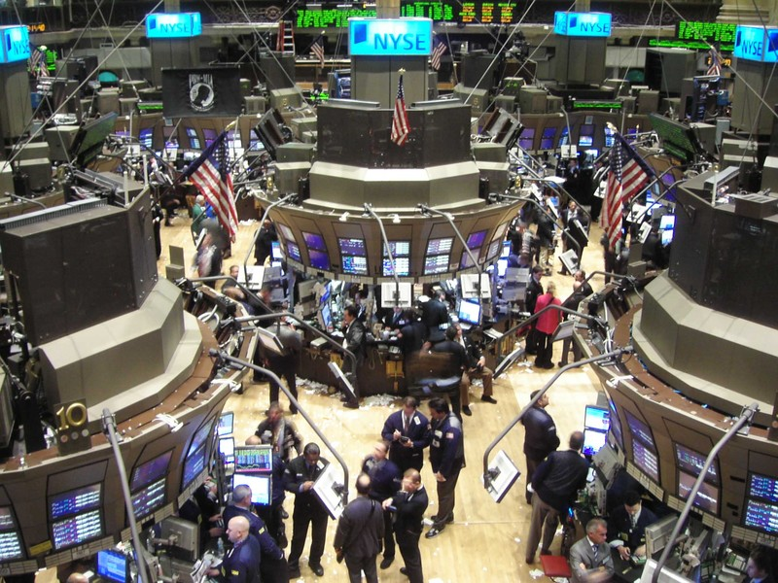

Slide 6
The Transient Response
In electrical engineering and mechanical engineering, a transient response or natural response is the response of a system to a change from equilibrium.
The transient response is not necessarily tied to "on/off" events but to any event that affects the equilibrium of the system.
The impulse response and step response are transient responses to a specific input (an impulse and a step, respectively).

Slide 7
Transient Response
Damping
The response can be classified as one of three types of damping that describes the output in relation to the steady-state response.
An underdamped response is one that oscillates within a decaying envelope. The more underdamped the system, the more oscillations and longer it takes to reach steady-state. Here damping ratio is always <1.
A critically damped response is the response that reaches the steady-state value the fastest without being underdamped. It is related to critical points in the sense that it straddles the boundary of underdamped and overdamped responses. Here, damping ratio is always equal to one. There should be no oscillation about the steady state value in the ideal case.
An overdamped response is the response that does not oscillate about the steady-state value but takes longer to reach than the critically damped case. Here damping ratio is >1

Slide 8
Typical second order transient system properties
Rise time
Rise time refers to the time required for a signal to change from a specified low value to a specified high value. Typically, these values are 10% and 90% of the step height.
Overshoot
Overshoot is when a signal or function exceeds its target. It is often associated with ringing.
Settling time
Settling time is the time elapsed from the application of an ideal instantaneous step input to the time at which the output has entered and remained within a specified error band.
Delay time
The delay time is the time required for the response to reach half the final value the very first time.
Peak time
The peak time is the time required for the response to reach the first peak of the overshoot.
Steady-state error
The difference between the desired final output and the actual one, when the system reaches a steady state, when its behavior may be expected to continue if the system is undisturbed
Note – in contrast to finance, vibrations is a separate subject that takes at least one semester of study in Engineering (electrical or mechanical) and it’s a field of it’s own using advanced mathematics. Thus we can benefit from the immense know-how in these type of events in the financial engineering or quant community

Slide 9

A Summary of the most simple math model commonly used in Engineering follows
For those not familiar with math e is the exponential function, where e is 2.71 approx, cos and sin are trigonometric functions related to the (x,y) points of the unit circle for an angle beta in radians. X is the independent variable and alpha, beta and c1 and c2 are coefficients that adjust the damping

Slide 10
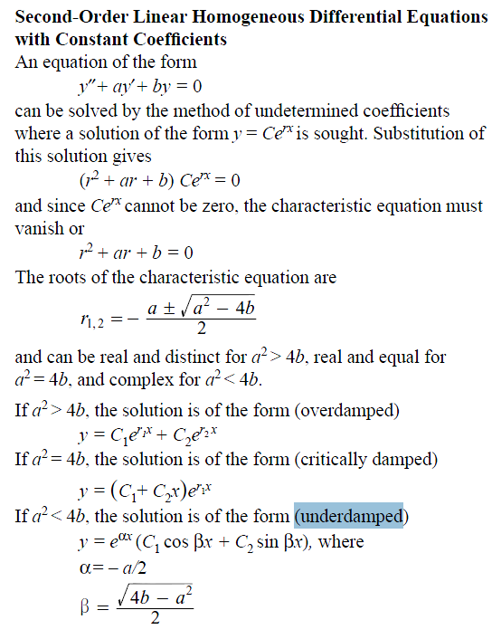
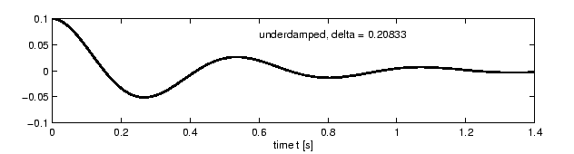
Note the underdamped model has the same angle for cosine and sine and a common factor exp…

Slide 11
Some Charts representing the actual data used
Since many chart forms are possible to visualize the event we plot a few of them

Slide 12
The Equity we used is FTWR
FiberTower Corporation
Some std tech trading charts have std Bollinger bands and a 2-day moving average (MA) candlestiock charts with with or without vol
Some are close-ups to show the response better
Some are excel charts with the 2D MA
Some are Matlab plots of the data using normalized time (time converted to a linear numeric scale)
Finally we have tables of the numeric data

Slide 13
FiberTower Corporation provides facilities-based backhaul services to wireless carriers in the United States.
Backhaul is the transport of voice, video, and data traffic from a wireless carrier's mobile base station, or cell site, to its mobile switching center or other exchange point where the traffic is then switched onto a wire line telecommunications network.
The company provides backhaul services by utilizing its wireless spectrum assets and fiber relationships to construct and operate high-coverage, high-capacity hybrid microwave, and fiber networks. It offers transport services based on various protocols, such as time division multiplexing, SONET, and Ethernet. As of March 31, 2011, the company provided services to 6,151 billing customer locations at 3,308 deployed sites in 13 markets, including Atlanta, Boston, Chicago, Cleveland, Dallas/Fort Worth, Denver, Detroit, Houston, New York/New Jersey, Pittsburgh, San Antonio/Austin/Waco, Washington DC/N. Virginia/S. Maryland, and west Florida.
FiberTower Corporation is headquartered in San Francisco, California.

Slide 14
The Possible Events or Catalyst for FTWR
On Mon Sept 12, 2011 on CNBC: In a news release this morning, Buffett's company says 50-year-old Ted Weschler of Charlottesville, Va., will join Berkshire early next year
In the meantime smart investors looked up what is the successors portfolio main investments
On Tue Sept 13, 2011 (same day) the successor of Buffets portfolio was revealed as having a major position in FTWR

Slide 15
URLs links to the news in Yahoo Finance
http://www.fool.com/investing/mutual-funds/2011/09/13/heres-how-buffetts-new-guy-is-invested.aspx
http://finance.yahoo.com/news/53M-Dinners-With-Warren-cnbc-69876001.html?x=0&.v=1
FTWR Details:
Market : NasdaqGS
Index Membership: N/A
Sector: Technology
Industry: Wireless Communications
Full Time Employees: 138

Slide 16
FiberTower Corporation
Market Cap (intraday)⁵: | 10.08M
Enterprise Value (Dec 22, 2011)³: | 170.37M
Trailing P/E (ttm, intraday): | N/A
Forward P/E (fye Dec 31, 2012)¹: | N/A
PEG Ratio (5 yr expected)¹: | N/A
Price/Sales (ttm): | 0.12
Price/Book (mrq): | 0.04
Enterprise Value/Revenue (ttm)³: | 1.96
Enterprise Value/EBITDA (ttm)⁶: | 32.69

Slide 17
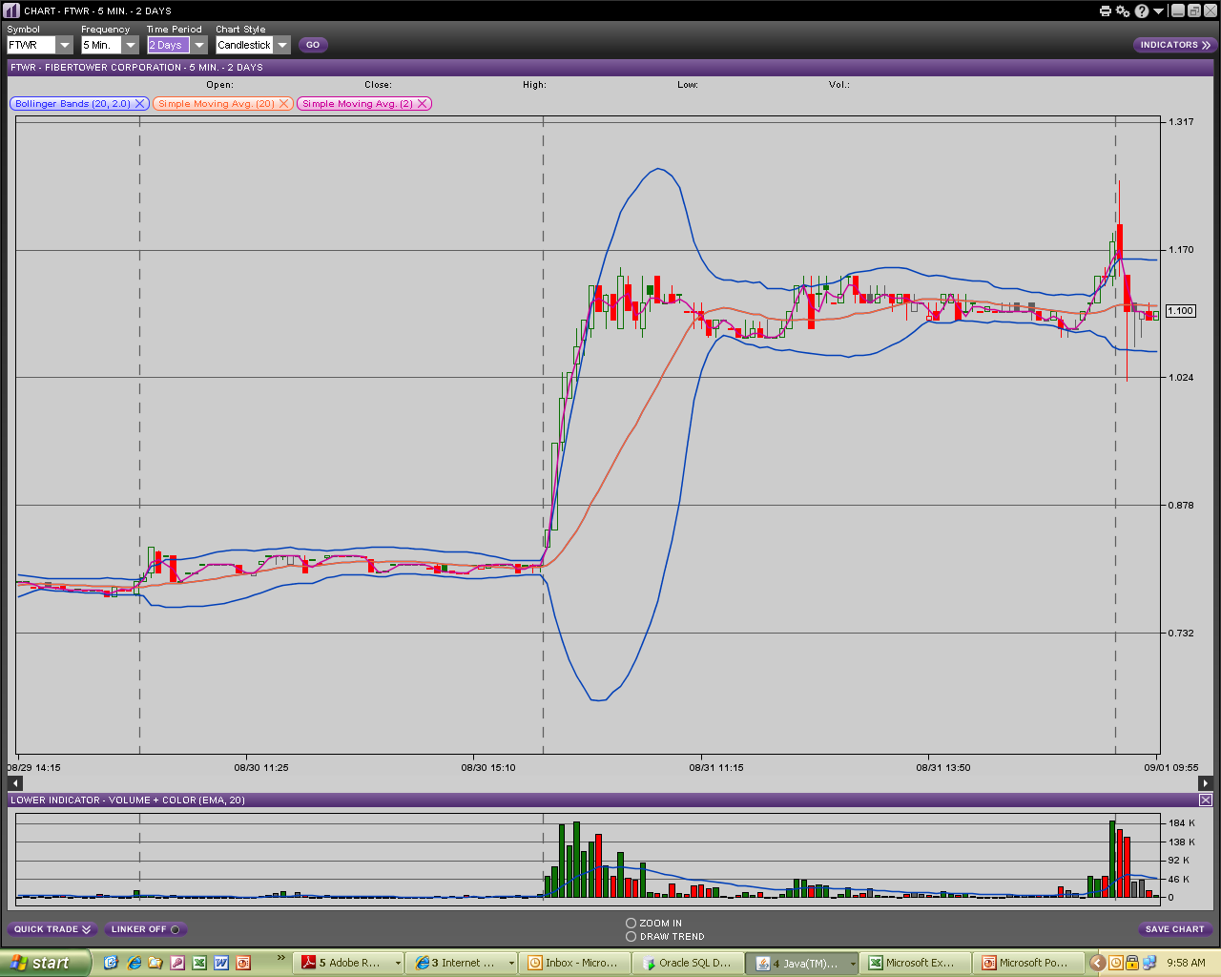

Slide 18
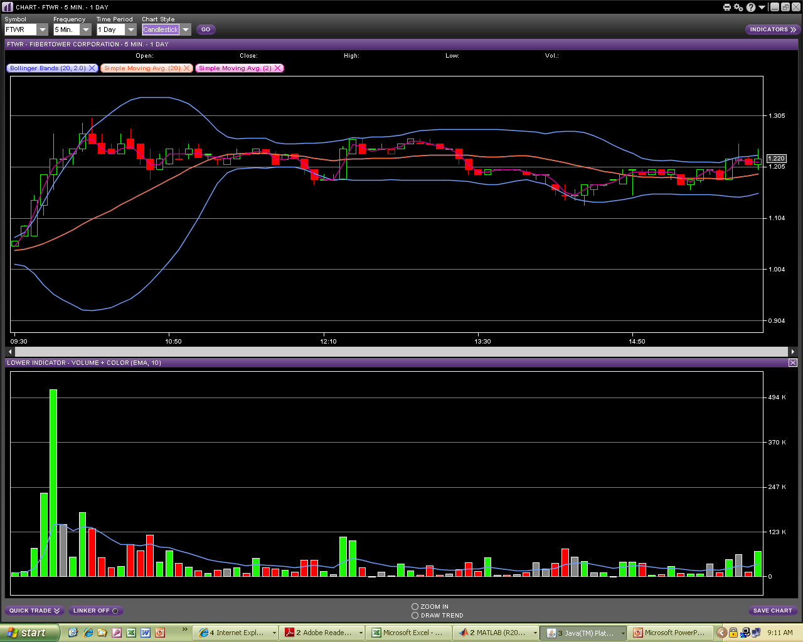
Volume trend

Slide 19
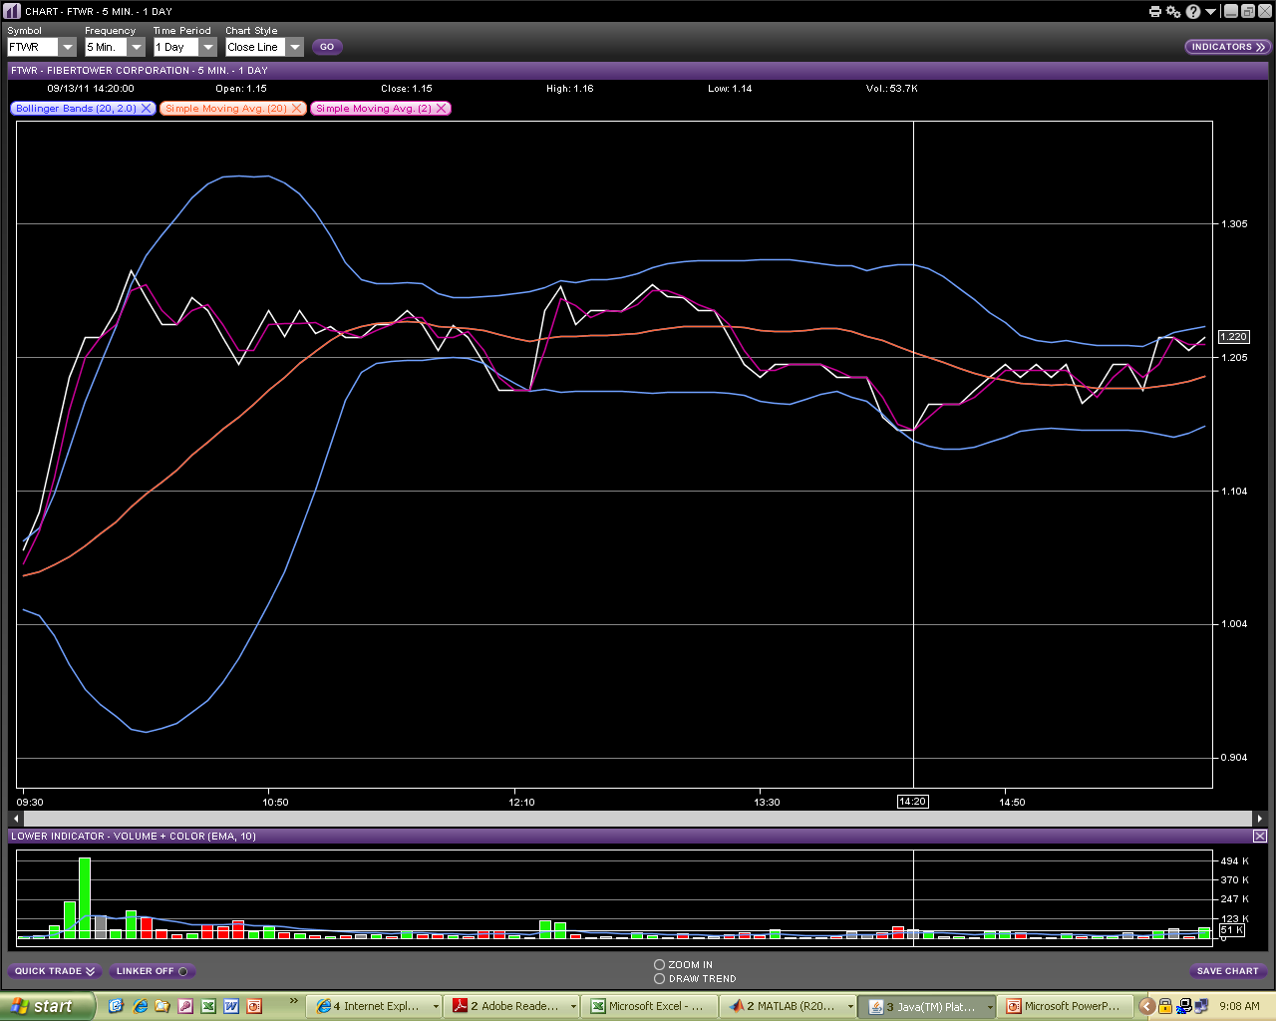
Use data from 9:30AM-12 from a 2-day simple moving avg as a basis for a fit
(the purple line) FTWR 9/13/11

Slide 20
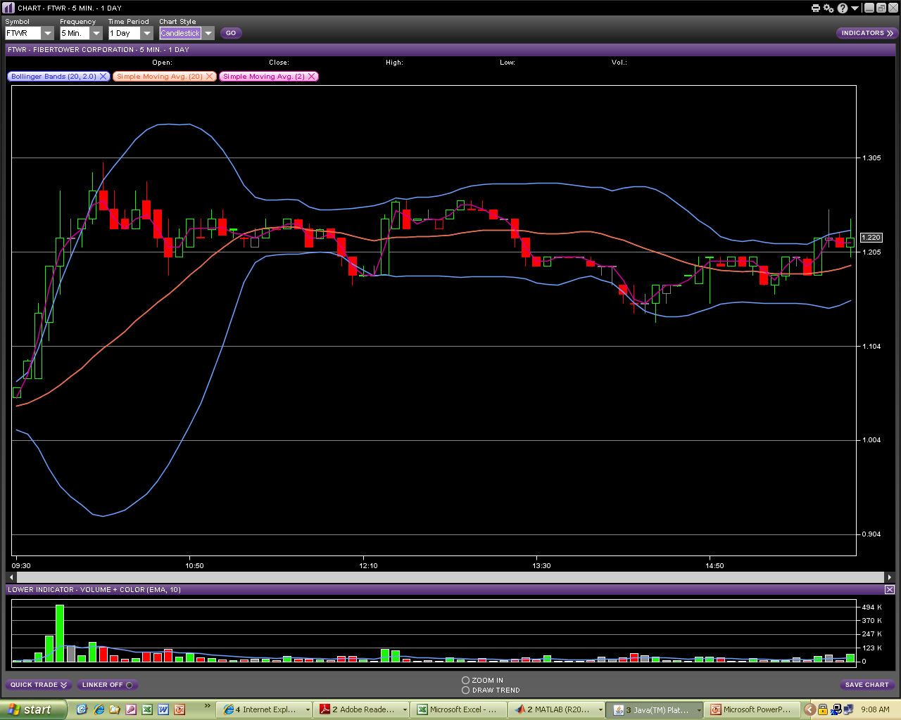

Slide 21
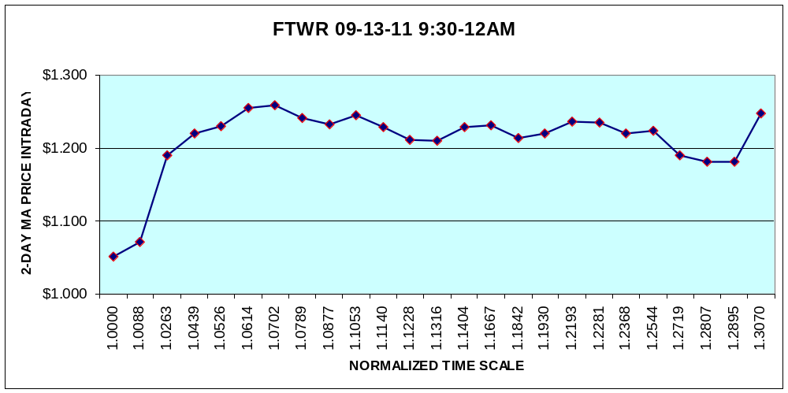
Line plot XY plot - excel chart of data

Slide 22

Smoothed XY plot line - excel chart of data

Slide 23
Line plot XY plot - excel chart of data

Slide 25
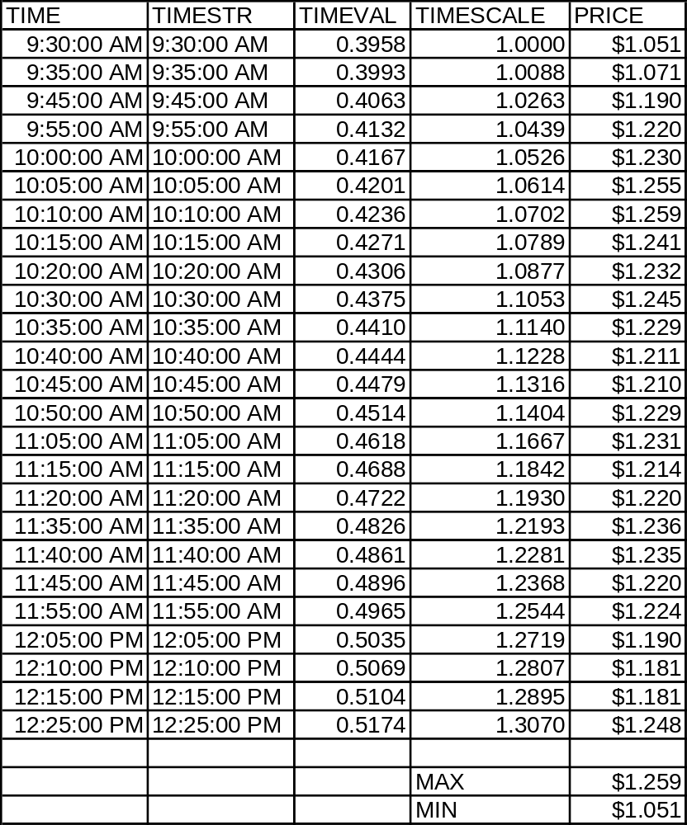
Actual data values for the equity.
Note the time intervals are not uniform

Slide 26
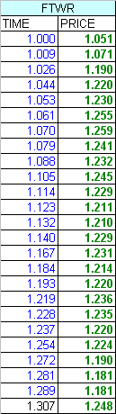
The ‘data’ array in the matlab workspace has this data after importing the equity trade data.
The max value is $1.259/share at normalized time 1.070 minutes from market startup

Slide 27
The Method used
Note the possible variables are alpha, beta, c1 and c2
for the std damping methods used in mech eng

Slide 28
Fitting A Vibration Model
This model is very different from the other curve fits, since vibration models are based on real physical models derived from ODE’s
We use a nonlinear fit between the stock actual data (time,price) and minimized the under damped form minus the actual data. Where min means to find the coef’s that result in underdamped curve – data points that is closest to zero or the points were the fit equals the data or is the closest. In Matlab it’s defined as either of:
und = exp(C1.*t).*(C2.*cos(C4.*t) + C3.*sin(C4.*t)) - p;
und = exp(C1.*t).*(C2.*cos(C4.*t) + C3.*sin(C5.*t)) - p;
We assume the std under damped model with 4 variables (same angle for cos and sin – beta, alpha and c1 and c2) and we obtain a poor, very smooth fit, except the top is ok but out of sync as shown in the next chart

Slide 29
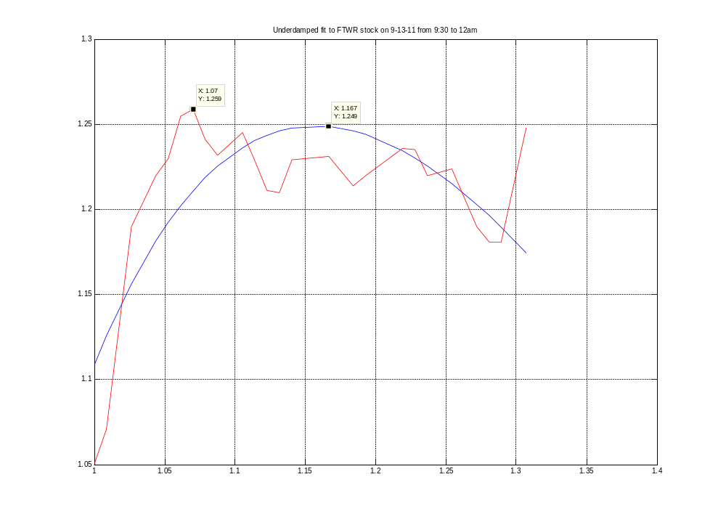
Result with the std 4 variables C1-C4 under damped model, the max value are not close in time

Slide 30
Fitting A Vibration Model
Since the std under damped model did not work well, and since the data has two levels of freedom, we include only price (ie: volume is missing as a factor) we tried adapting the underdamped model by letting the angles for the cos and sin to be different.
Note the same basic model is still used – but in a more general form
In this case we found a striking fit and both the time scale and the max value were very close.
The result is at normalized time 1.079 both charts coincided on the value $1.241 were the max value was just before at 1.07 for $1.259.
A very small difference in time and price
We conclude that this innovative 5-variables damped system can produce excellent forecasts of max values for a catalysts equity events.
See the next chart for the comparison of the model results plot vs the equity data plot. In the std equation below we allow beta to be different for cosine and sine, so we have 5 variables:

Slide 31
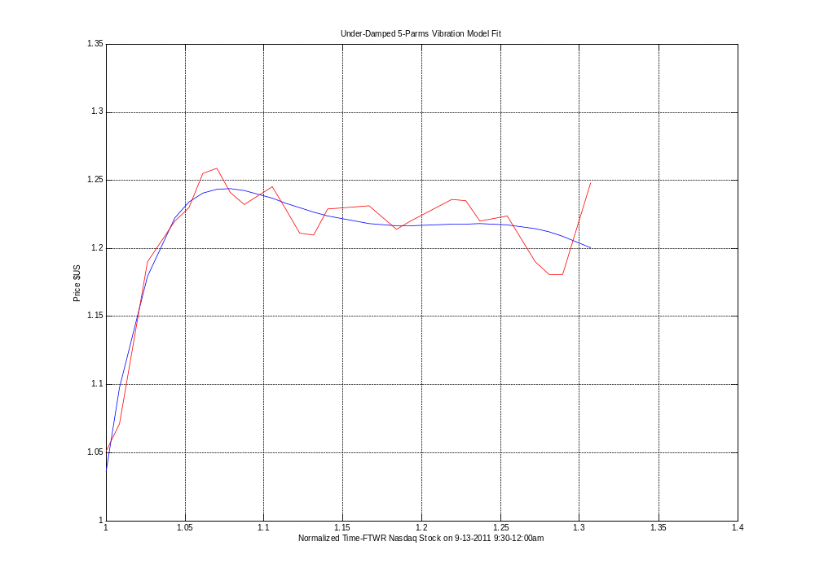

Slide 32
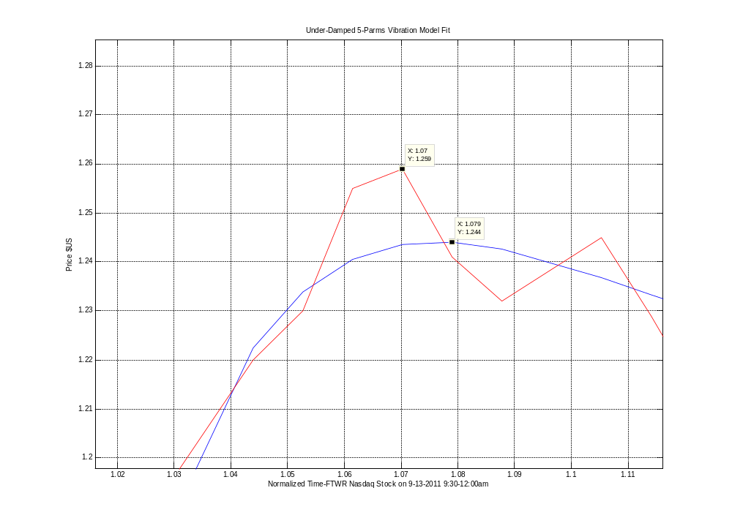
Closeup of the top values

Slide 33
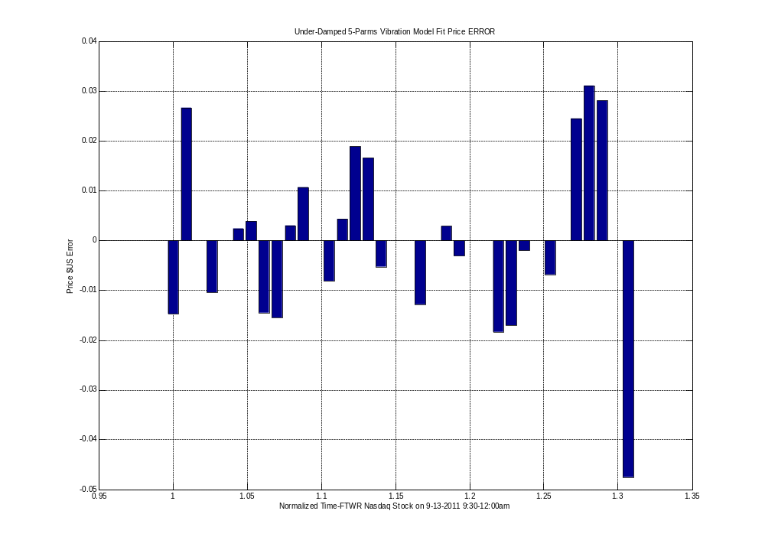
The price error or (fit-price – equity-price) plot per time.
We note many zero error! Also the last point is the larget error close to $-0.05 a common issue with fitted data. Most are less than +/- $0.02.

Slide 34
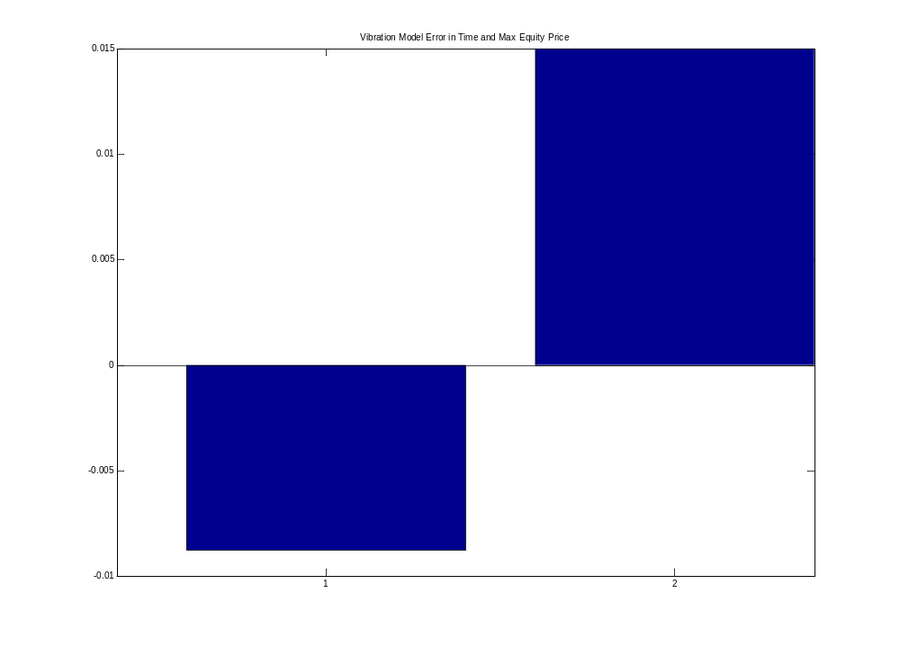

Slide 35
Basic Matlab Codes
We have a function that defines the 5-parm or variables damped vibration model and subtracts the data p and then we have a calling program that uses ‘lqnonlin’ to optimize this function for all possinle parameters c1-c5

Slide 36
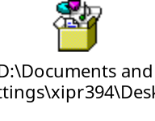
function und=fit_undamped2(x,t,p)
  % fit a linear ode with const coefs - underdamped form
  % test - added diff angle for sine
  C1=x(1);
  C2=x(2);
  C3=x(3);
  C4=x(4);
  C5=x(5);
  und = exp(C1.*t).*(C2.*cos(C4.*t) + C3.*sin(C5.*t)) - p;
  % if zero then ==> exp(C1.*t).*(C2.*cos(C4.*t) + C3.*sin(C4.*t)) = price
  % at time = t
end

Slide 37
disp '-- starting least sqr eval --'
importfile('FTWR-IMPORT_DATA.xls')
% loads data into variable named data with t,p - time series and prices
t=data(:,1)';
p=data(:,2)';
% Initialize the coefficients of the function
in=1
X0=[in in in in in]';
% 2nd angle for sin c1-c5
% Set an options file for LSQNONLIN to use the
% maxfunevals default of 800 not sufficient
options1 = optimset('Display','iter','MaxIter',20000,'Largescale','off','MaxFunEvals',20000);
% Calculate the new coefficients using LSQNONLIN
% [x,resnorm,residual,exitflag,output,lambda,jacobian]
x=lsqnonlin(@fit_undamped2,X0,[],[],options1,t,p);
C1=x(1);
C2=x(2);
C3=x(3);
C4=x(4);
C5=x(5);
% plot solution
len=0.01
X=t;
Y=exp(C1.*t).*(C2.*cos(C4.*t) + C3.*sin(C5.*t));
figure
plot(X,Y)
hold on
plot(X,p,'-r')
grid on
title 'Underdamped fit#2 to FTWR stock on 9-13-11 from 9:30 to 12am - 5 vars'

Slide 38
disp '-- starting least sqr eval --'
importfile('FTWR-IMPORT_DATA.xls')
% loads data into variable named data with t,p - time series and prices
t=data(:,1)';
p=data(:,2)';
% Initialize the coefficients of the function
in=1
X0=[in in in in in]';
% 2nd angle for sin c1-c5
% Set an options file for LSQNONLIN to use the
% maxfunevals default of 800 not sufficient
options1 = optimset('Display','iter','MaxIter',20000,'Largescale','off','MaxFunEvals',20000);
% Calculate the new coefficients using LSQNONLIN
% [x,resnorm,residual,exitflag,output,lambda,jacobian]
x=lsqnonlin(@fit_undamped2,X0,[],[],options1,t,p);
C1=x(1);
C2=x(2);
C3=x(3);
C4=x(4);
C5=x(5);
% plot solution
len=0.01
X=t;
Y=exp(C1.*t).*(C2.*cos(C4.*t) + C3.*sin(C5.*t));
figure
plot(X,Y)
hold on
plot(X,p,'-r')
grid on
title 'Underdamped fit#2 to FTWR stock on 9-13-11 from 9:30 to 12am - 5 vars'
Here we emphasize the main code lines – least squares non linear fit and the final chart using the underdamped coef’s passed in x[] to c1-c5

Slide 39
The values obtained for C1 to C5
>> C1
C1 = -6.6178
>> C2
C2 = -3.0065e+004
>> C3
C3 = -6.0912e+003
>> C4
C4 = 1.5423
>> C5
C5 = 6.0121
>>
We can see that we do have very different values for the angles c4 and c5 (radians)
  und = exp(C1.*t).*(C2.*cos(C4.*t) + C3.*sin(C5.*t)) - p;

Slide 40
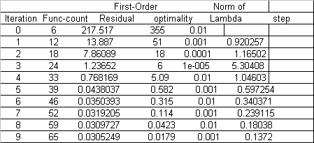
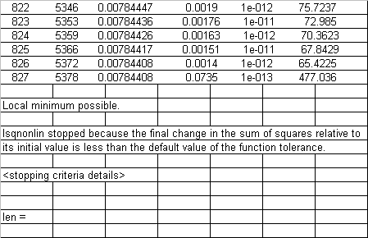
Matlab run time output for fit for lsqnonline (least squares)
…

Slide 41
Comparison with other std curve fits using Matlab powerful curve fitting toolbox
Note that all these curve fits have NO basis in theory. They are purely numerical best fits of some class of functions and have no basis to be related to the equity data. They usually fit the data well, but then have some problems either at the ends, and have no parameters that can be adjusted for other events since the coef’s generated are arbitrary

Slide 42
Fitted – 7 Degree Polynomial
Warnings during fitting:
Equation is badly conditioned. Remove repeated data points
or try centering and scaling.
Linear model Poly7:
f(x) = p1*x^7 + p2*x^6 + p3*x^5 + p4*x^4 + p5*x^3 +
p6*x^2 + p7*x + p8
Coefficients (with 95% confidence bounds):
p1 = 6.103e+004 (-1.67e+005, 2.891e+005)
p2 = -4.619e+005 (-2.304e+006, 1.38e+006)
p3 = 1.493e+006 (-4.877e+006, 7.863e+006)
p4 = -2.671e+006 (-1.489e+007, 9.548e+006)
p5 = 2.856e+006 (-1.119e+007, 1.69e+007)
p6 = -1.827e+006 (-1.15e+007, 7.844e+006)
p7 = 6.47e+005 (-3.048e+006, 4.342e+006)
p8 = -9.792e+004 (-7.022e+005, 5.063e+005)
Goodness of fit:
SSE: 0.002559
R-square: 0.9566
Adjusted R-square: 0.9388
RMSE: 0.01227

Slide 43
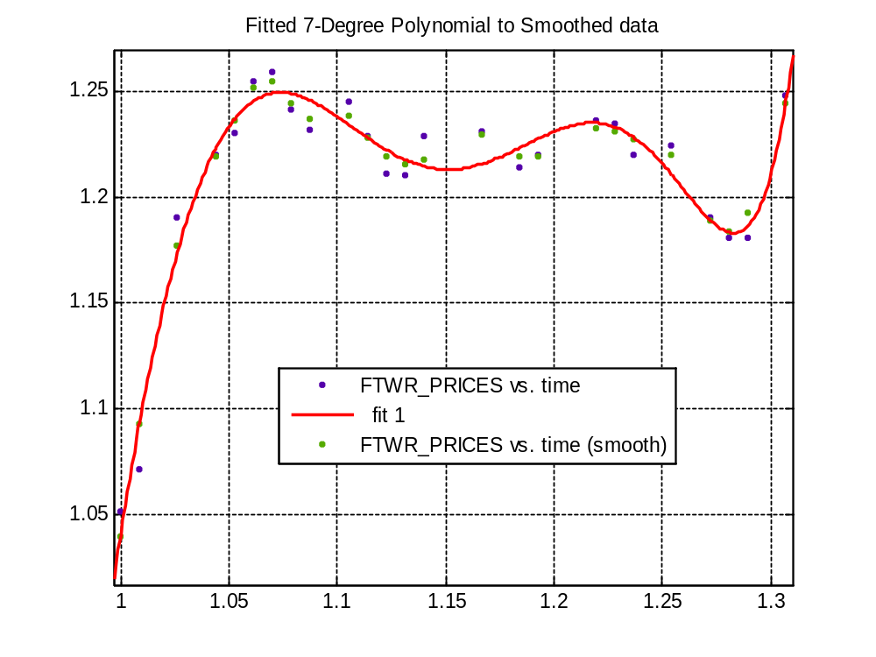

Slide 44
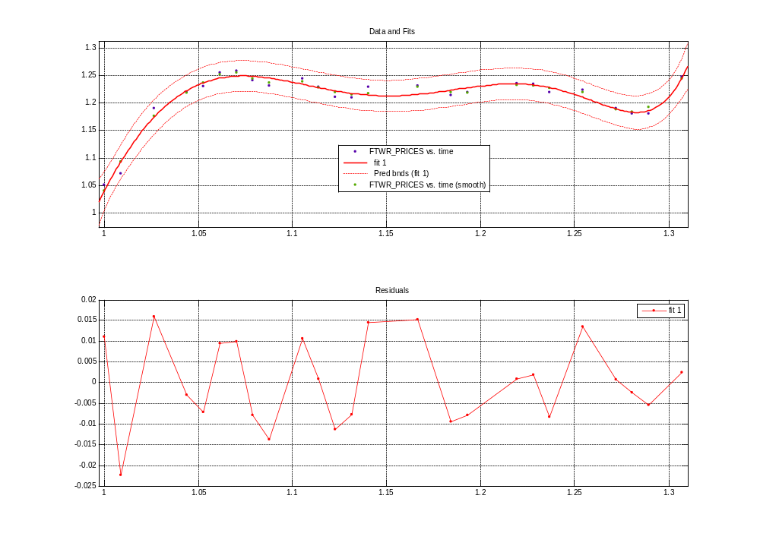

Slide 45
Fitted – Rational 5-th degree poly
General model Rat55:
f(x) =
(p1*x^5 + p2*x^4 + p3*x^3 + p4*x^2 + p5*x + p6) /
(x^5 + q1*x^4 + q2*x^3 + q3*x^2 + q4*x + q5)
Coefficients (with 95% confidence bounds):
p1 = 1.094 (-1.229e+007, 1.229e+007)
p2 = 0.122 (-9.801e+009, 9.801e+009)
p3 = -1.239 (-2.052e+009, 2.052e+009)
p4 = -0.791 (-9.301e+009, 9.301e+009)
p5 = -0.7816 (-1.513e+010, 1.513e+010)
p6 = 1.6 (-1.672e+010, 1.672e+010)
q1 = -0.09591 (-8.834e+009, 8.834e+009)
q2 = -0.9407 (-3.076e+009, 3.076e+009)
q3 = -0.7288 (-8.284e+009, 8.284e+009)
q4 = -0.4532 (-1.026e+010, 1.026e+010)
q5 = 1.223 (-1.281e+010, 1.281e+010)
Goodness of fit:
SSE: 0.006464
R-square: 0.8904
Adjusted R-square: 0.8122
RMSE: 0.02149

Slide 46
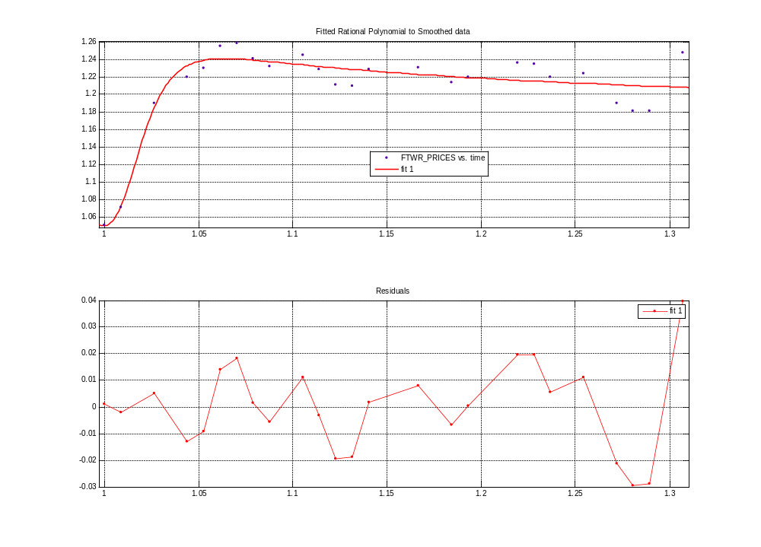

Slide 47
Fitting: Smoothing spline
Smoothing spline:
f(x) = piecewise polynomial computed from p
Smoothing parameter:
p = 0.99999984
Goodness of fit:
SSE: 0.000562
R-square: 0.9905
Adjusted R-square: 0.9746
RMSE: 0.007901

Slide 48
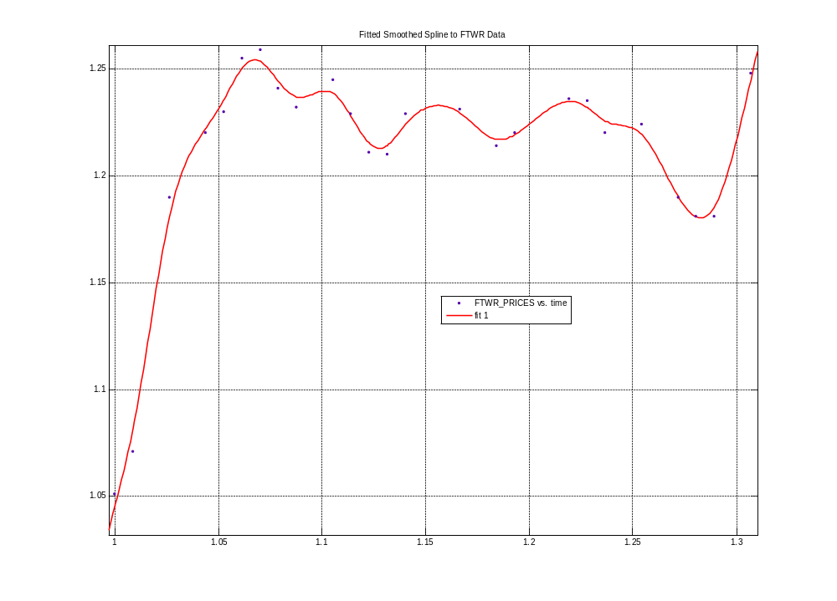

Slide 49
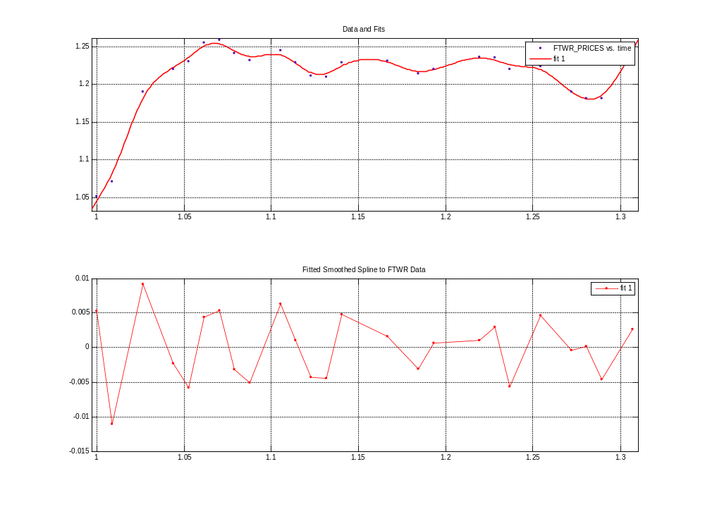

Slide 50
Fitting using - General model – sum of 8 Sines:
f(x) = a1*sin(b1*x+c1) + a2*sin(b2*x+c2) + a3*sin(b3*x+c3) + a4*sin(b4*x+c4) + a5*sin(b5*x+c5) + a6*sin(b6*x+c6) + a7*sin(b7*x+c7) + a8*sin(b8*x+c8)
where x is normalized by mean 1.147 and std 0.09455
Coefficients (with 95% confidence bounds):
a1 = 1.655 (-8.965e+008, 8.965e+008)
b1 = 0.7871 (-3.694e+008, 3.694e+008)
c1 = 1.43 (-7.955e+007, 7.955e+007)
a2 = 0.6636 (-9.202e+007, 9.202e+007)
b2 = 2.045 (-1.765e+009, 1.765e+009)
c2 = -1.947 (-2.946e+008, 2.946e+008)
a3 = 0.2479 (-9.844e+008, 9.844e+008)
b3 = 2.843 (-7.977e+008, 7.977e+008)
c3 = 1.052 (-1.924e+008, 1.924e+008)
a4 = 0.02393 (-1.795e+006, 1.795e+006)
b4 = 5.441 (-9.933e+008, 9.933e+008)
c4 = -2.107 (-2.35e+007, 2.35e+007)
a5 = 0.02057 (-8.398e+006, 8.398e+006)
b5 = 7.257 (-4.452e+008, 4.452e+008)
c5 = 1.176 (-5.788e+007, 5.788e+007)
a6 = 0.00828 (-1.095e+006, 1.095e+006)
b6 = 9.423 (-1.817e+008, 1.817e+008)
c6 = -1.601 (-3.305e+007, 3.305e+007)
a7 = 0.02475 (-5.888e+004, 5.888e+004)
b7 = 11.68 (-1.547e+006, 1.547e+006)
c7 = -0.8968 (-3.13e+006, 3.13e+006)
a8 = 0.02869 (-2.826e+005, 2.826e+005)
b8 = 11.21 (-8.993e+006, 8.993e+006)
c8 = 1.744 (-2.091e+006, 2.091e+006)
Goodness of fit:
SSE: 0.002238
R-square: 0.9621
Adjusted R-square: 0.0895
RMSE: 0.04731

Slide 51
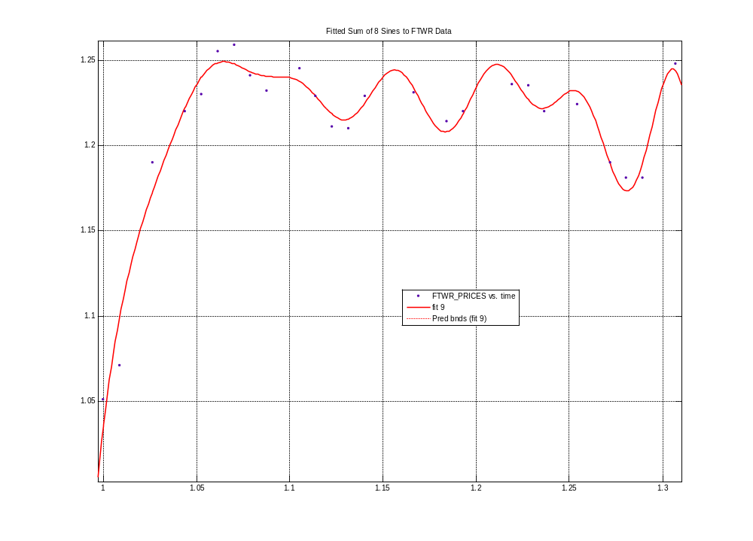

Slide 52
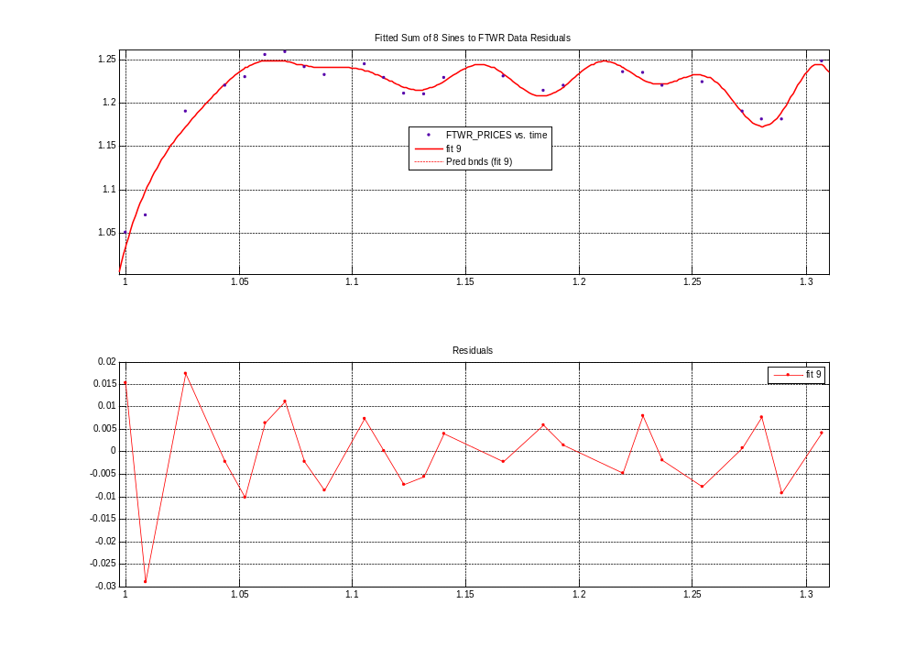

Slide 53
Fitting: Two Gaussian functions (exponentials)
General model Gauss2:
f(x) = a1*exp(-((x-b1)/c1)^2) + a2*exp(-((x-b2)/c2)^2)
Coefficients (with 95% confidence bounds):
a1 = 0.1702 (-0.02659, 0.367)
b1 = 1.052 (1.02, 1.085)
c1 = 0.06398 (0.01414, 0.1138)
a2 = 1.228 (1.212, 1.243)
b2 = 1.226 (1.187, 1.264)
c2 = 0.462 (0.2346, 0.6895)
Goodness of fit:
SSE: 0.0081
R-square: 0.8627
Adjusted R-square: 0.8266
RMSE: 0.02065

Slide 54
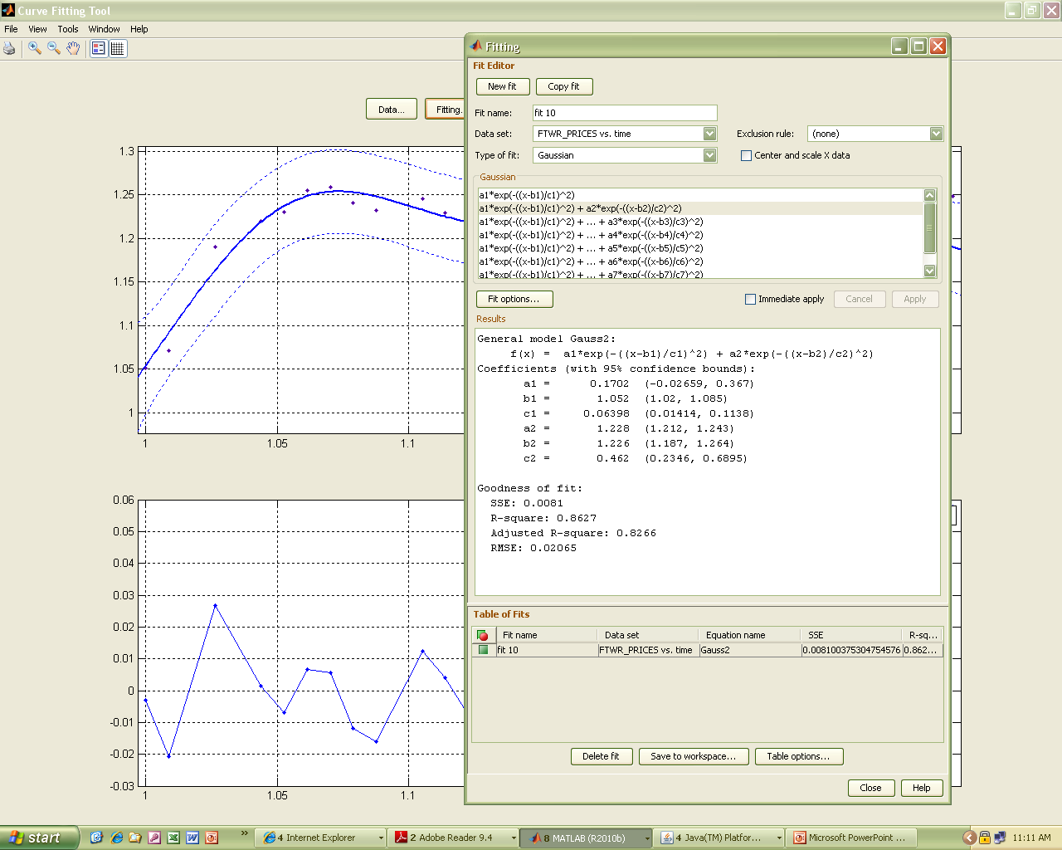

Slide 55
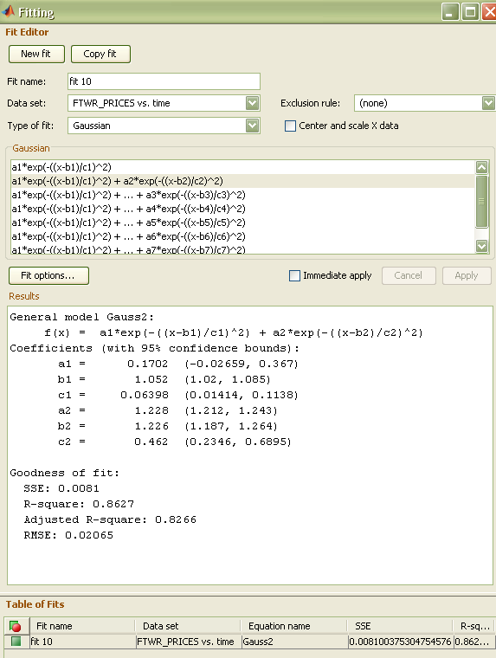

Slide 56
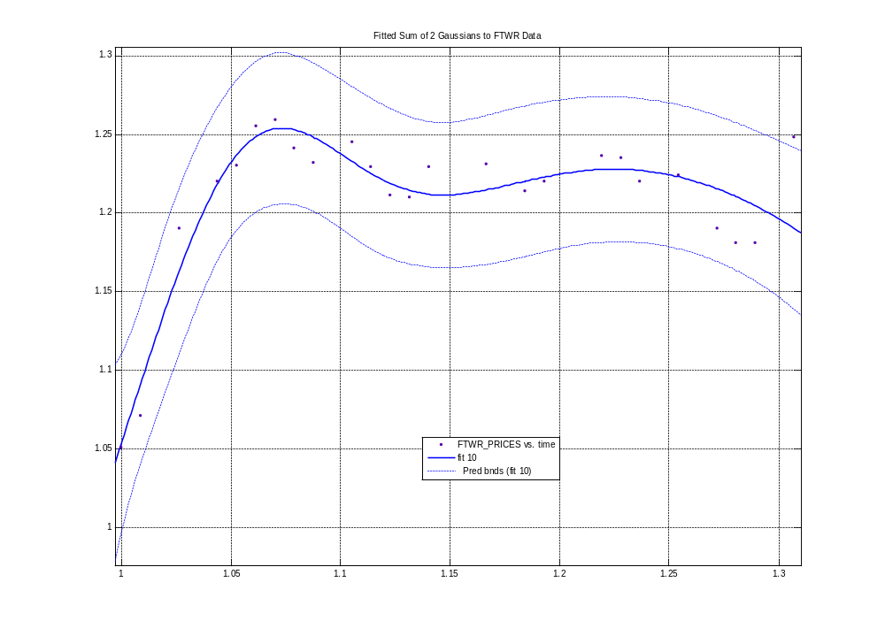

Slide 57
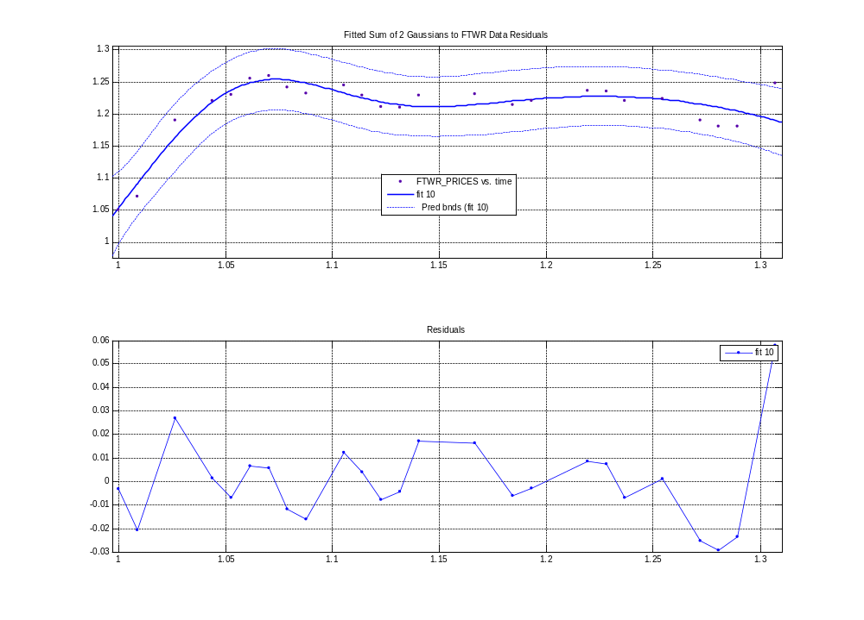

Slide 58
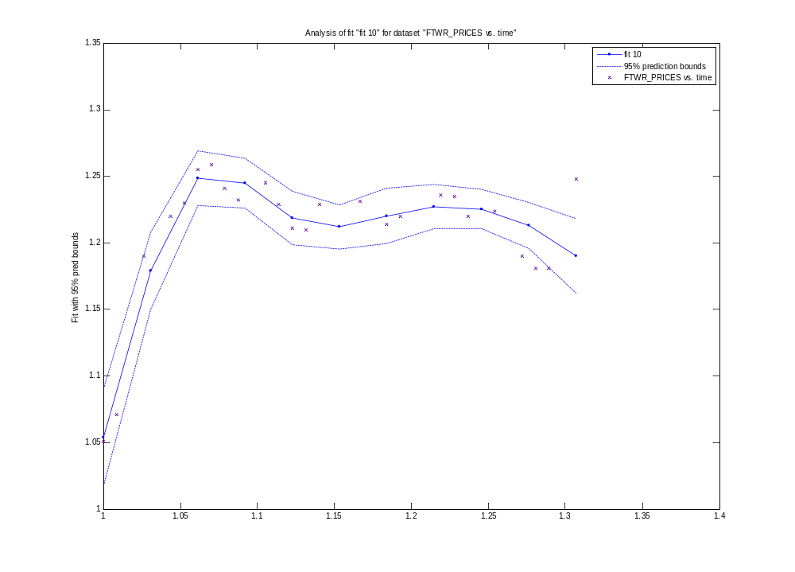

Slide 59
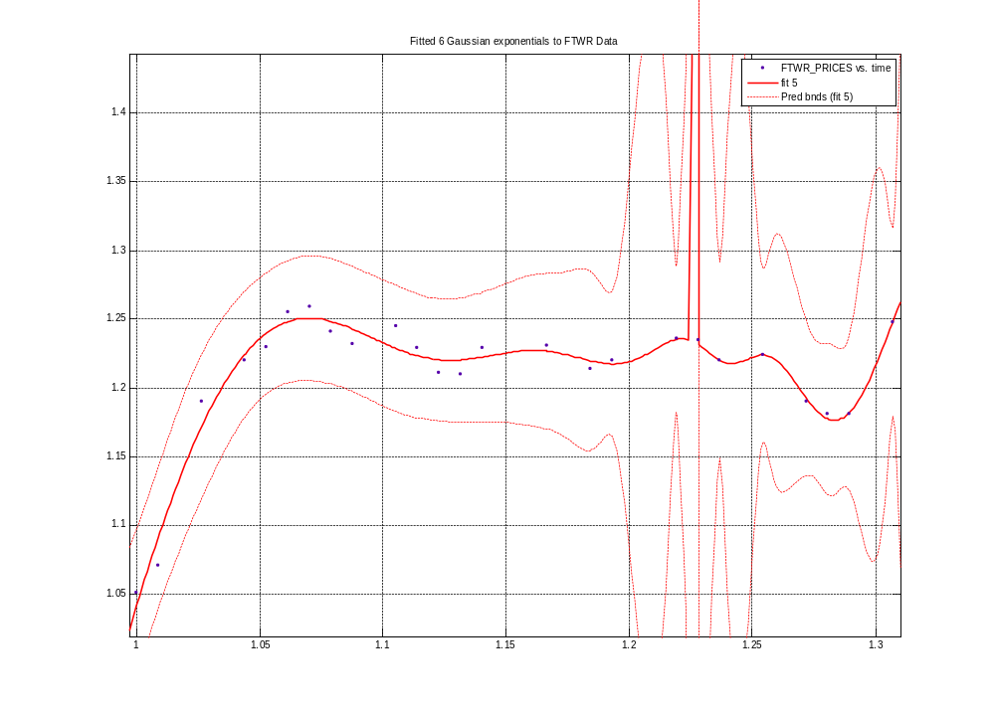

Slide 60
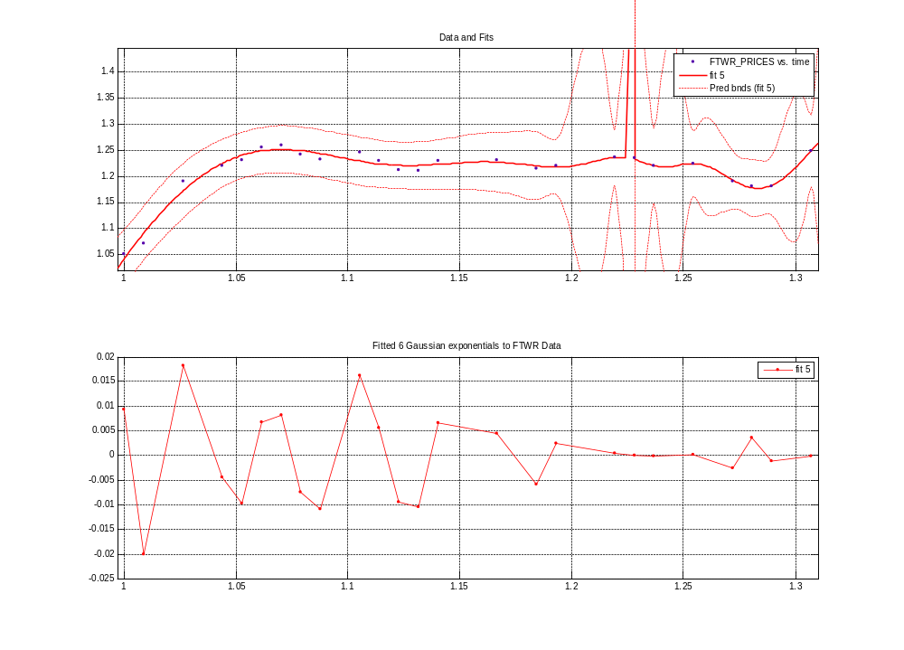

Slide 61
Fitting: Weibull Distribution
General model Weibull:
f(x) = a*b*x^(b-1)*exp(-a*x^b)
Coefficients (with 95% confidence bounds):
a = 0.3965 (0.3713, 0.4216)
b = 4.149 (4.062, 4.236)
Goodness of fit:
SSE: 0.03839
R-square: 0.3494
Adjusted R-square: 0.3211
RMSE: 0.04085

Slide 62
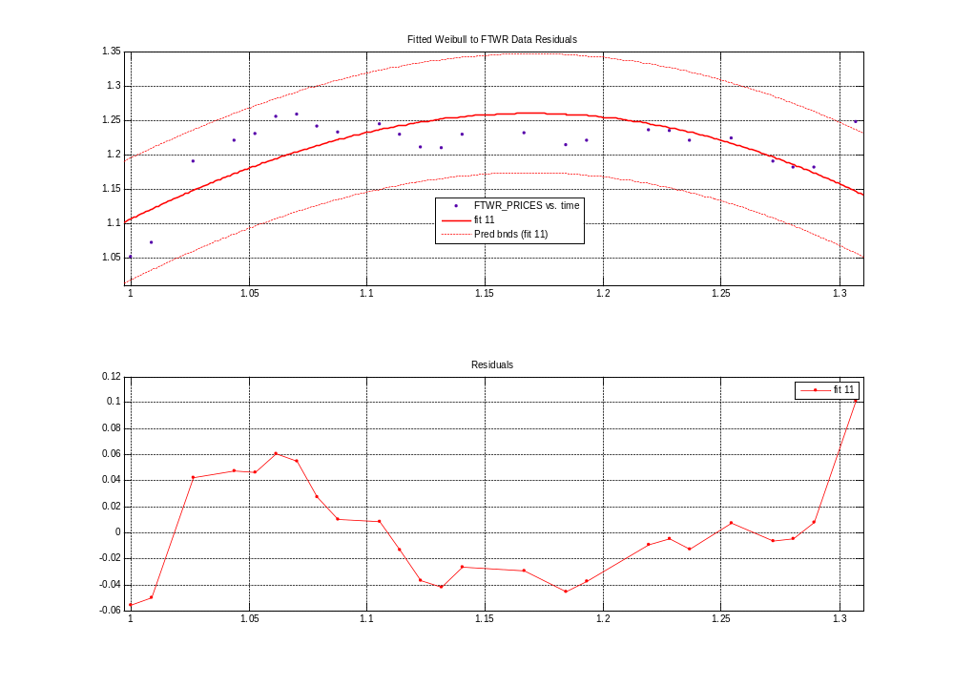

Slide 64
Smoothed splines – a near perfect fit to the data

Slide 65
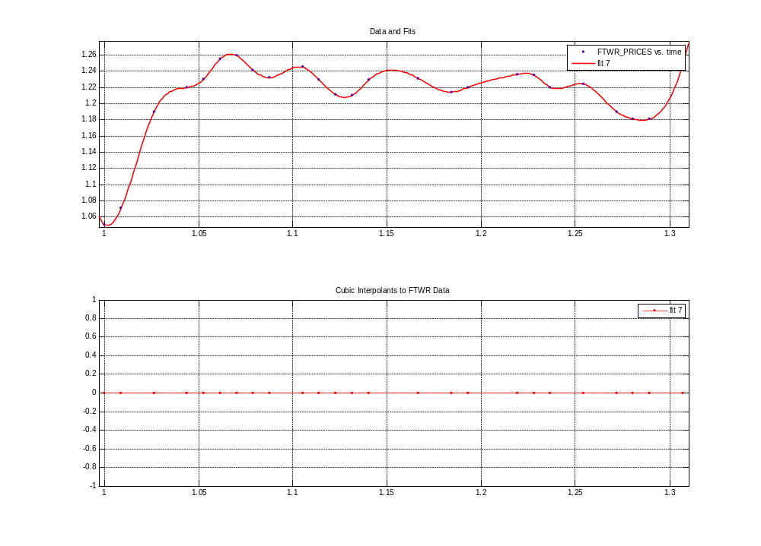
Cubic interpolants – a perfect fit to data points

